Slide 1
혁신성장 청년인재 집중양성
IAMEDIC
서승훈, 서준영, 이재호, 장진영

Slide 2
프로젝트 개요
기획 배경, 목표: (2d vs 3d + 논문구현 + 서비스?)
시장 분석: 의료 AI 영상(기업들) 썰 ( ) + 의료데이터 관련법
BraTS 대회 요약: (unet domination)
구성원 및 역할
프로젝트 추진 일정
분석 및 개발 결과
MRI썰
Modality, Biascorrection (EDA)
2D 내용 및 결과
3D 내용 및 결과
구현 내용 및 결과
-표 (keras구현모델 돌려본 결과)
기대효과
- prototype
누군가 brats2020 나간다면…. 우리거 보고 참고….
실무연계 (의사들이 사용)
향후 개선 사항
기대 효과
후기

Slide 3
I. 프로젝트 개요

Slide 6
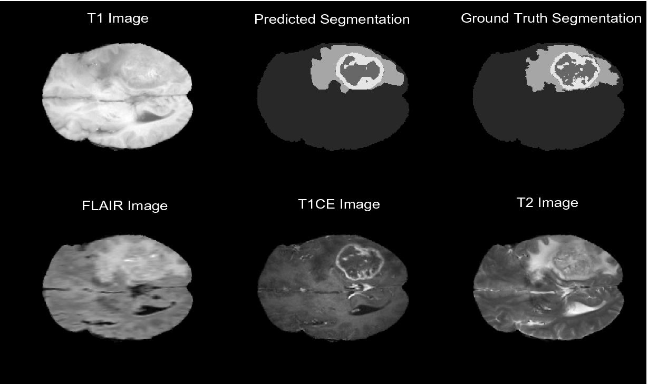
Multimodal images
Lee
Choudhury et al.
Segmentation of Brain Tumors Using DeepLabv3+

Slide 7
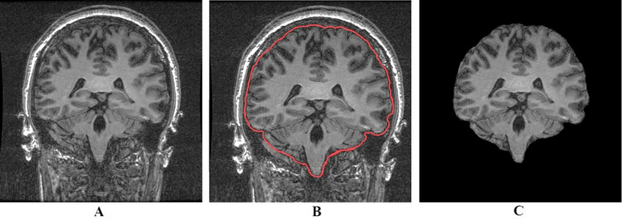
Preprocessing – skull stripping
Lee
Hosseini et al
Automatic and Manual Segmentation of Hippocampus in Epileptic Patients MRI

Slide 8
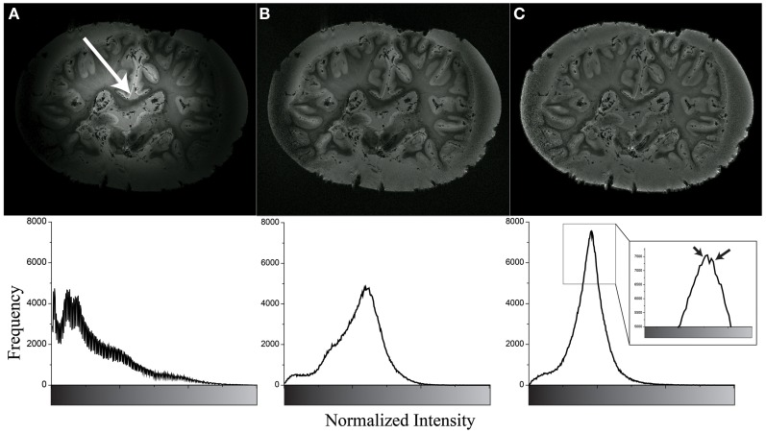
Preprocessing – N4 biasfield correction
Lee
Yang et al
Integration of ultra-high field MRI and histology for connectome based research of brain disorders

Slide 9
II. 분석, 개발 결과

Slide 10
3D Unet: Data prep
Lee
3D BTS 모델의 흐름도. (generator 부재에 따른 복잡도 증가)
전처리
두개골 제거, 정렬,
(N4 biascorrection, directory and file renaming)
Building H5 Files
Normalization
Generating input
Model

Slide 11
논문 및 소스코드 탐색
Lee
Repositories | Competition | Framework | Paper | model | Note
Naomifridman | X (2019 data) | keras | X | 2D Unet | ipynb
Cv-lee | X (2017 data) | Keras, pytorch | X | 2D Unet +
Woodywff | * Brats 2019 | keras | O | 3D Unet | weights.h5
JhonleeHit | * Brats 2019 | keras | O | Cascading 3D Unet
ellisdg | * Brats 2018 | keras | X | 3D Unet | 1.1k Star
China-LiuXiaopeng | * Brats 2018 | pytorch | O | 3D DMFNet
Bluesky314 | * Brats 2018 | pytorch | O | 3D Unet
Jack Etheridge | *Brats 2018 | keras | X | 3D Unet
Repositories | Competition | Framework | Paper | model | Note
Naomifridman | X (2019 data) | keras | X | 2D Unet | ipynb
Woodywff | * Brats 2019 | keras | O | 3D Unet | weights.h5
ellisdg | * Brats 2018 | keras | X | 3D Unet | 1.1k Star

Slide 12
3D Unet: F. Isensee, D.G.Ellis, F.Wang
Lee
Function Reliances
https://github.com/ellisdg/3DUnetCNN
unet3d/utils/sitk_utils.py
unet3d/utils/utils.py
unet3d/normalize.py
unet3d/data.py
brats/train.py
unet3d/generator.py
unet3d/training.py
create_patch_index_list
step_decay
unet3d/utils/patches.py
sitk_resample_to_spacing
find_downsized_info
get_random_nd_index
get_callbacks
add_data_to_storage
fetch_training_data_files
compute_patch_indices
load_old_model
get_set_of_patch_indices
get_cropping_parameters
create_data_file
get_number_of_steps
get_random_nd_index
main
get_number_of_patches
compute_patch_indices
write_image_data_to_file
create_patch_index_list
get_set_of_patch_indices
sitk_resample_to_image
reslice_image_set
reslice_image_set
If) fetch_training_data_files
get_data_from_file
get_random_patch_index
sitk_new_blank_image
get_affine
If) get_cropping_parameters
get_patch_from_3d_data
get_random_nd_index
read_image_files
read_image_files
add_data_to_storage
add_data
fix_out_of_bound_patch_attempt
write_data_to_file
If) write_data_to_file
get_data_from_file
get_patch_from_3d_data
fix_shape
create_data_file
augment_data
fix_out_of_bound_patch_attempt
resize
normalize_data
write_image_data_to_file
random_permutation_x_y
reconstruct_from_patches
calculate_origin_offset
convert_data
augment_data
resample_to_spacing
read_image
normalize_data_storage
if) normalize_data_storage
get_multi_class_labels
fix_shape
normalize_data
open_data_file
split_list
random_permutation_x_y
resize
get_foreground_from_set_of_files
open_data_file
get_validation_split
unet3d/augment.py
sitk_image_to_data
get_complete_foreground
split_list
get_foreground_from_set_of_files
data_generator
create_patch_index_list
data_to_sitk_image
pickle_dump
add_data
pickle_dump
pickle_load
pickle_load
get_training_and
_validation_generators
get_training_and_validation_generators
get_validation_split
data_generator
get_number_of_steps
get_number_of_patches
train_model
train_model
keras.model.fit_generator
get_callbacks

Slide 13
3D Unet: Process
Lee
Raw
Dataset
Dataset(h5)
Data
X
Model
Predict
Y

Slide 14
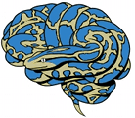



3D Unet: Hurdles
Lee
Raw
Dataset
Preprocessing
Reading .nii images
Creating h5 file
N4Biasfield correction
Normalization, Resizing
Dataset(h5)
nibabel
Pytables
ANTs
Sitk
Unfamiliar liararies
Data
X
Model
Predict
Y

Slide 15
3D Unet: Hurdles
Lee
Raw
Dataset
Datagenerator
Read data
Create patches
Augment images
Dataset(h5)
Data
X
Model
Predict
Y

Slide 16
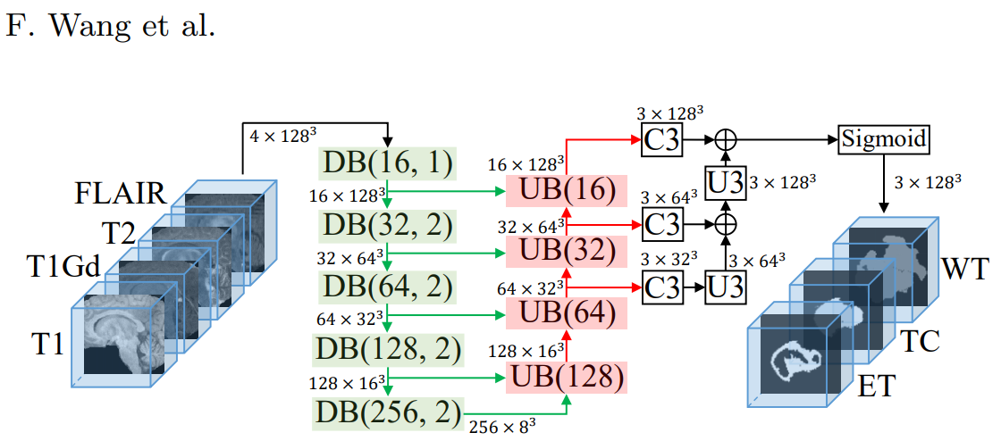
3D Unet: Model
Lee

Slide 17
3D Unet:
Lee
Slightly modified wang et al.’s code and confirmed its validity
Tensorflow-gpu 1.11 -> Tensorflow2.2
Linux -> Linux & Windows
Achieved close-to-paper performance
움 짤 or Table

Slide 18
Lee
Woody | Dice_ET | Dice_WT | Dice_TC
Mean | 0.70435 | 0.87965 | 0.77177
StdDev | 0.31391 | 0.12735 | 0.21786
Median | 0.84422 | 0.91493 | 0.85847
25quantile | 0.66238 | 0.8654 | 0.68042
75quantile | 0.90042 | 0.94082 | 0.91917
1.3 (3D) | Dice_ET | Dice_WT | Dice_TC
Mean | 0.69375 | 0.86642 | 0.75452
StdDev | 0.31087 | 0.11886 | 0.23451
Median | 0.82093 | 0.901 | 0.85524
25quantile | 0.64492 | 0.84033 | 0.68875
75quantile | 0.89683 | 0.93383 | 0.91136
Naomi(2D) | Dice_ET | Dice_WT | Dice_TC
Mean | 0.53331 | 0.75312 | 0.61569
StdDev | 0.30197 | 0.15143 | 0.24508
Median | 0.66802 | 0.80616 | 0.66856
25quantile | 0.32074 | 0.71237 | 0.50583
75quantile | 0.75444 | 0.84666 | 0.80821

Slide 19
Lee
 | WT | TC | ET
2D (N.Fridman)
3D (Wang et al.)

Slide 20
III. 기대효과

Slide 25
IV. 후기

Slide 26
Lee
개선할 점
1. Outlier Prediction 분석
2. 방사선, 신경외과 전문의와 협업
-> 의사결정과정을 배우고 참고할 수 있었다면 더 좋았을 것.
3. 다양한 augmentation 도입을 통해 더 나은 regularization이 가능할 것
-> ITK, Sitk에 3d nii image augmentation관련 코드가 구현되어 있음 -> 적극 활용
4. H5 파일 사용시 validation 및 training 파일 분리. (multi threaded generator 접근)
5. Multistep, cascading segmentation 적용(대세)
아쉬운점
진입장벽을 예상못하고 데이터 전처리 및 generator 관련부분에 시간을 많이 허비하게 되어 아쉬움이 남음.
기타
팀원들이 모두 적극적으로 끝까지 임해줘서 고마웠고, 스스로도 분발할 수 있었음.
조성훈멘토님, 임비멘토님을 비롯한 멘토님들의 도움 덕분에 이정도나마 해낼 수 있었음.

